Slide 1
HZ Shopping Application
Hifza Zaheer

Slide 2
The Product Brief
To create:
Fully functional CRUD Application
Using MySQL Relational Database with minimum two tables manipulation
Utilisation of Flask for front-end website and integrated API's
Fully designed test suits for the CRUD Application including automated test
Use of tools, methodologies and technologies which encapsulate all the core modules covered during training.

Slide 3
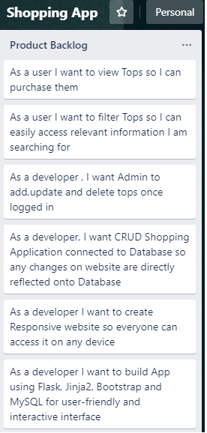
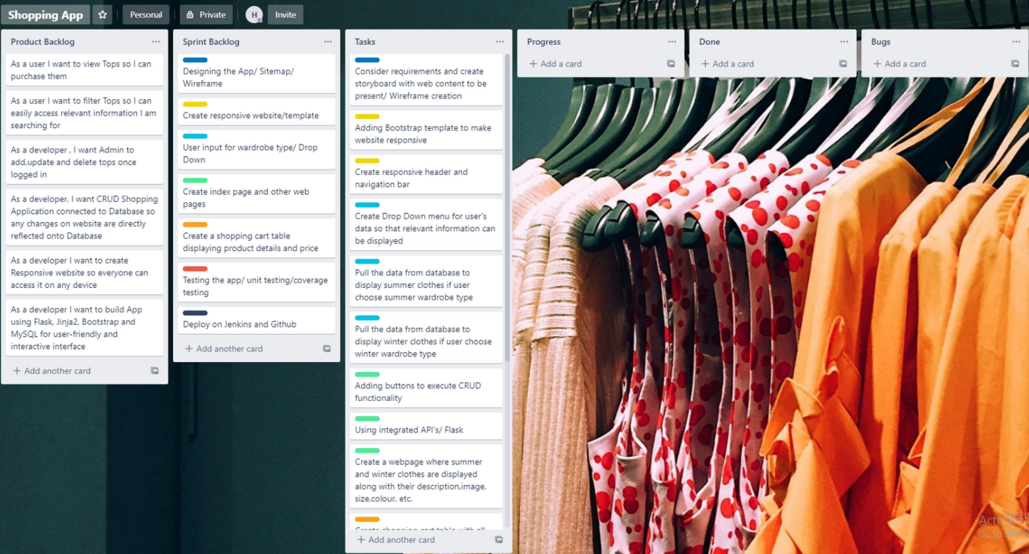
Initial Project planning/ trello

Slide 4
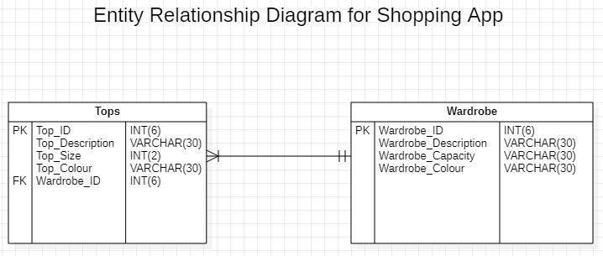
Initial database design/ erd

Slide 5
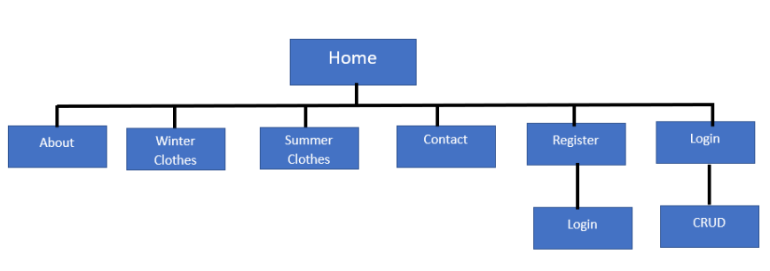
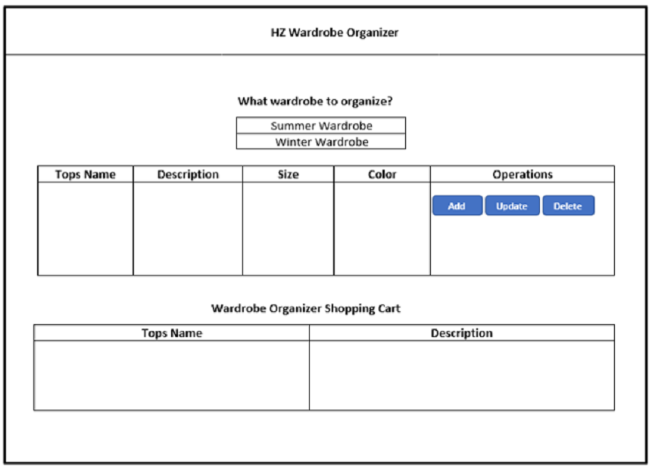
Initial Website design
Sitemap
Wireframe

Slide 6
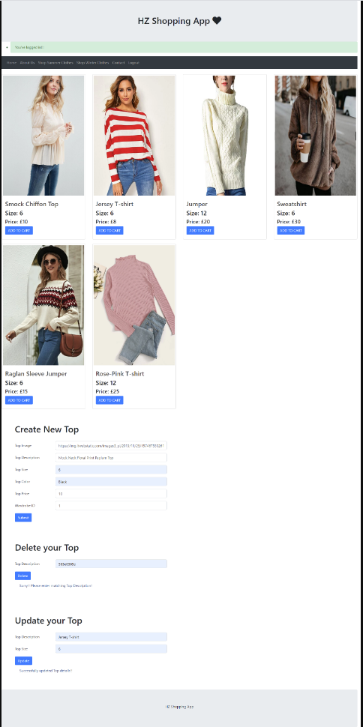
My solution

Slide 7
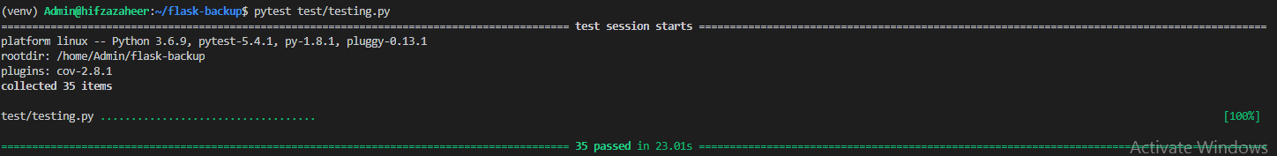
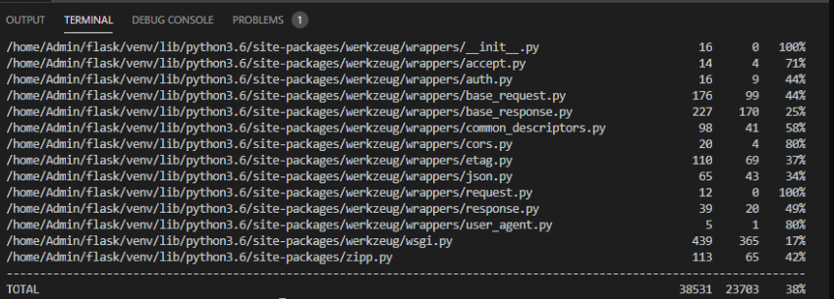
testing
Unit Testing
Coverage Testing

Slide 8
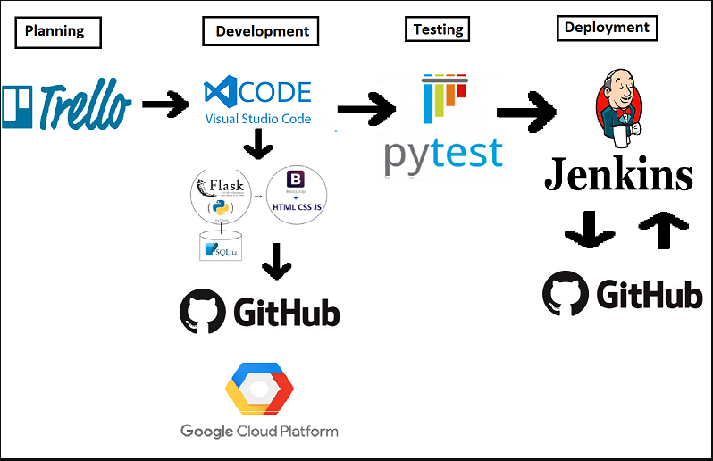
DEPLOYMENT/ JENKINS
CI/CI Pipeline

Slide 9
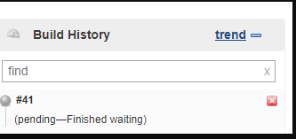
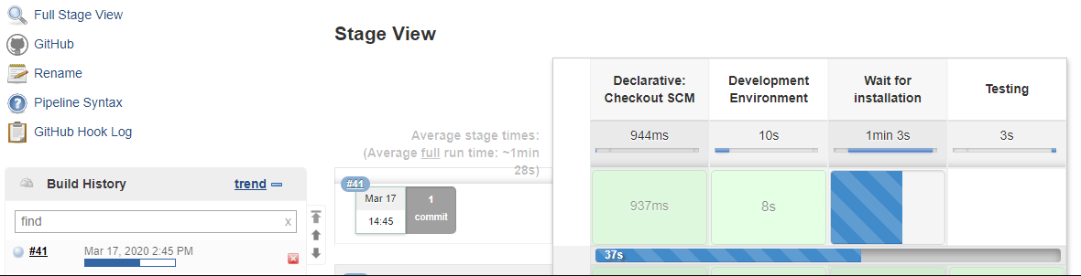
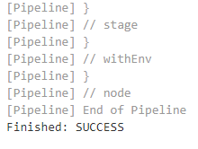
DEPLOYMENT/ JENKINS
Auto- Build using Webbooks
How the process looks:
Jenkins waiting to trigger the build once change was fully committed:
Jenkins Build triggered automatically once change was committed:

Slide 10
Evaluation
What went well | Challenges | Improvements for Future
Creating Front-End | Auto Build Trigger | Selenium Testing
Creating MySQL Database | Jenkins to deploy and test App | Deploy the App on 3 different servers (DEV, TEST,PROD)
Managing/Planning Project | Coverage Testing to score more | Add more features (search, accessibility features,etc.)

Slide 11

Any question?

